Slide 1
DS 4300
Replicating Data
Mark Fontenot, PhD
Northeastern University
Some material used with permission from Dr. Rachlin, with thanks!

Slide 2
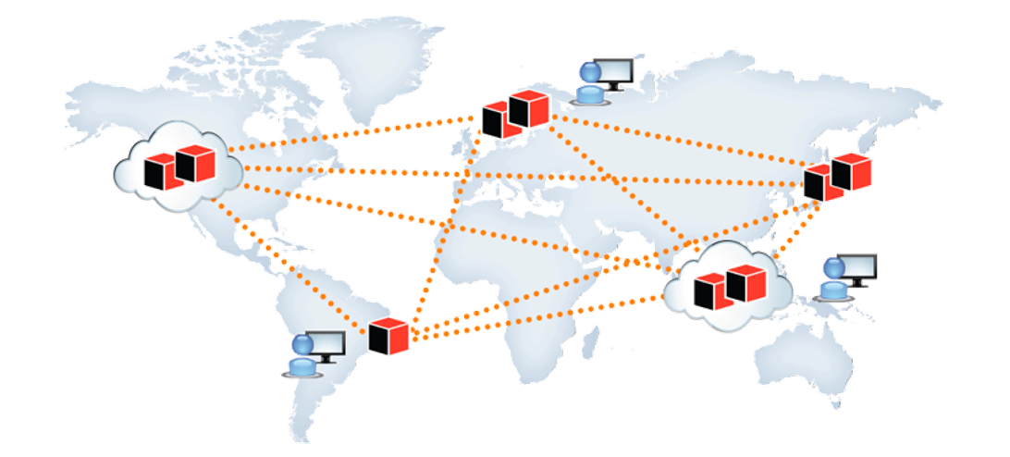
Distributing Data - Benefits
Scalability / High throughput: Data volume or Read/Write load grows beyond the capacity of a single machine
Fault Tolerance / High Availability: Your application needs to continue working even if one or more machines goes down.
Latency: When you have users in different parts of the world you want to give them fast performance too

Slide 3
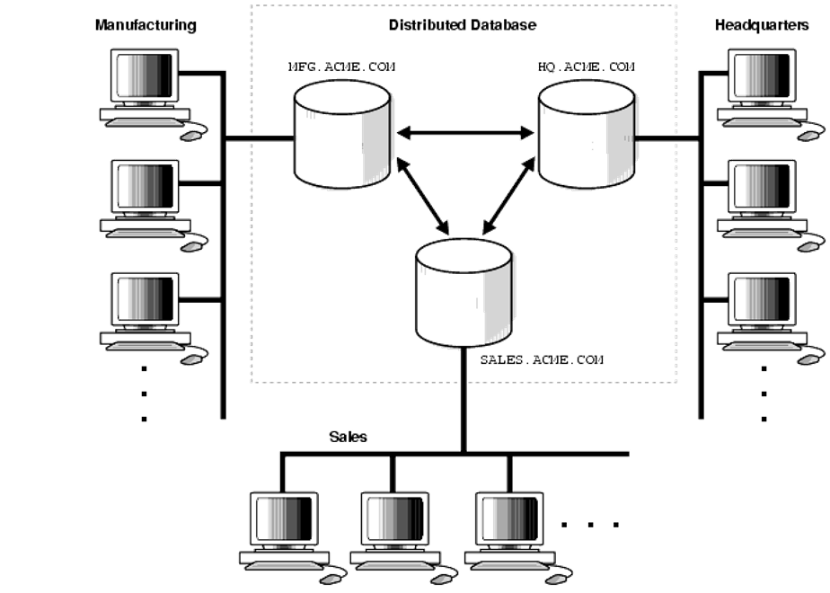
Distributed Data - Challenges
Consistency: Updates must be propagated across the network.
Application Complexity: Responsibility for reading and writing data in a distributed environment often falls to the application.

Slide 4
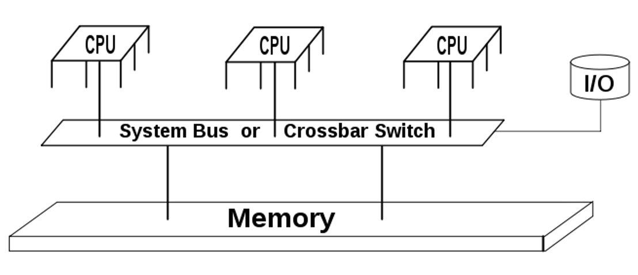
Vertical Scaling - Shared Memory Architectures
Geographically Centralized server
Some fault tolerance (via hot-swappable components)

Slide 5
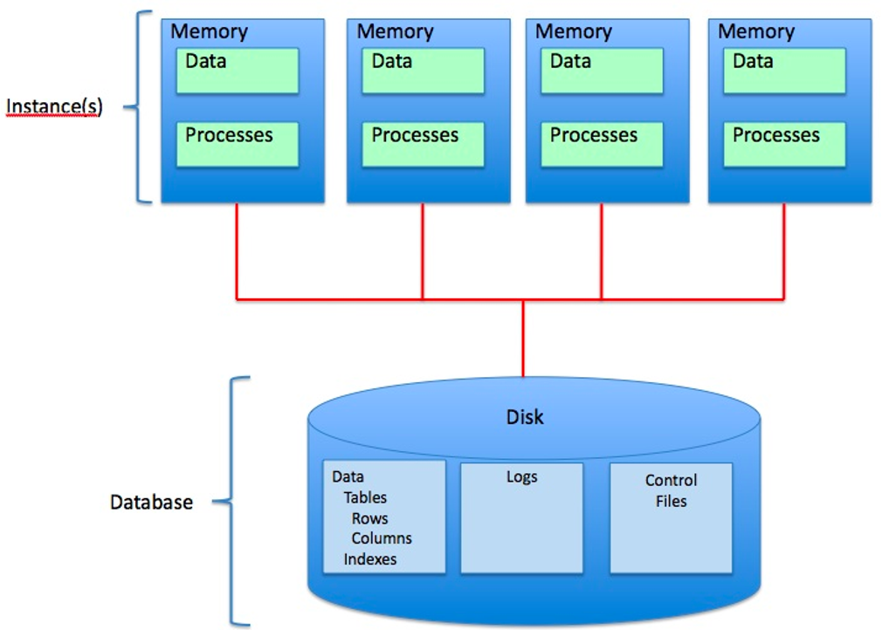
Vertical Scaling - Shared Disk Architectures
Machines are connected via a fast network
Contention and the overhead of locking limit scalability (high-write volumes) … BUT ok for Data Warehouse applications (high read volumes)

Slide 6
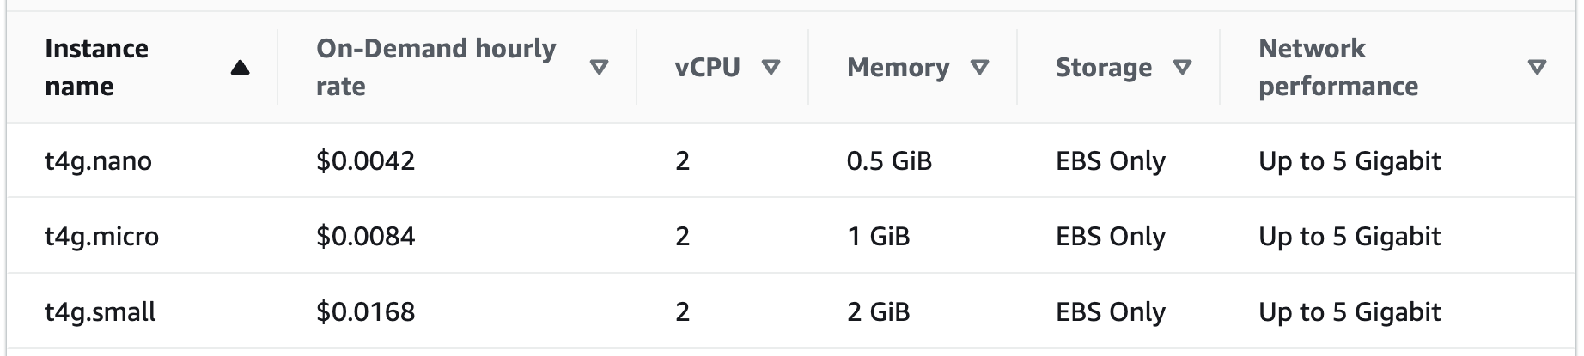
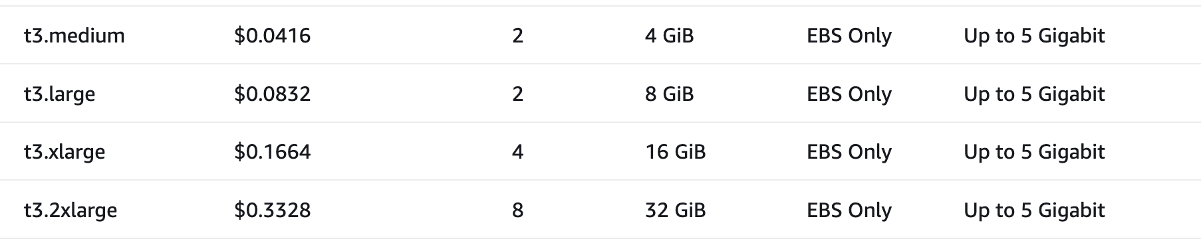
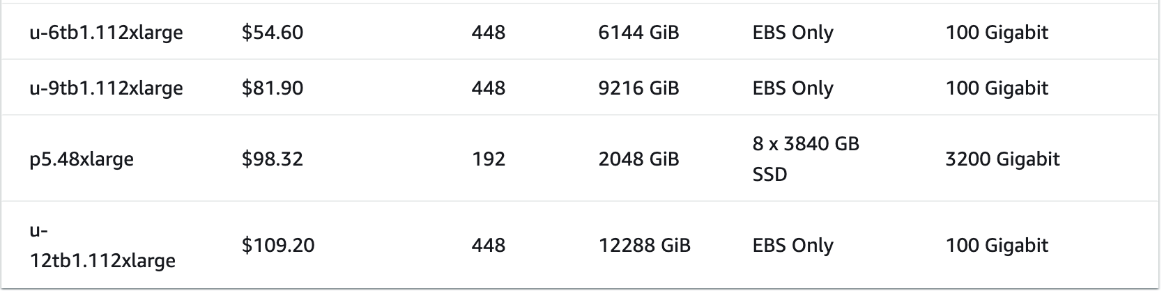
AWS EC2 Pricing - Oct 2024
https://aws.amazon.com/ec2/pricing/on-demand/
> $78,000/month

Slide 7
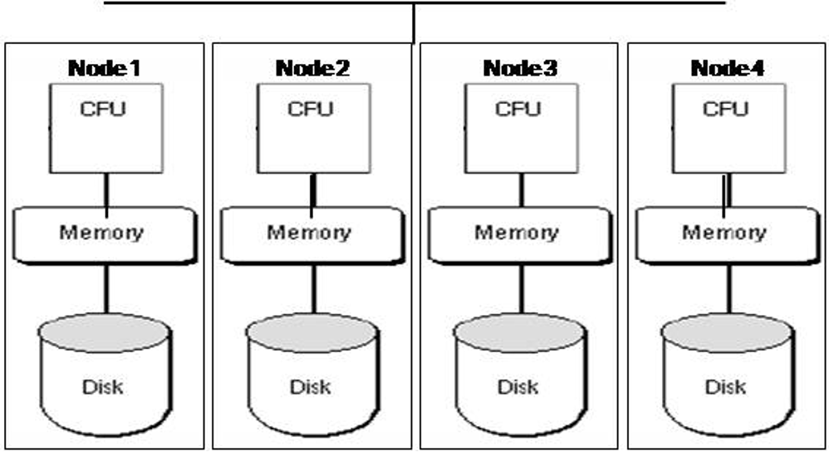
Horizontal Scaling - Shared Nothing Architectures
Each node has its own CPU, memory, and disk
Coordination via application layer using conventional network
Geographically distributed
Commodity hardware

Slide 8
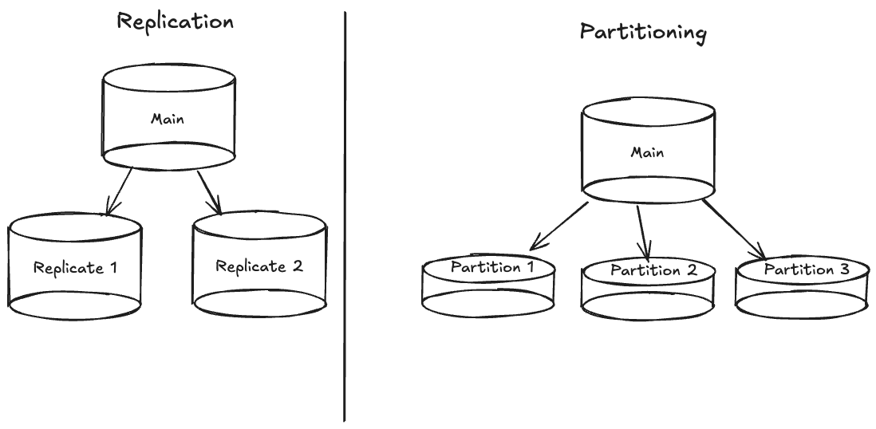
Data - Replication vs Partitioning
Replicates have same data as Main
Partitions have a subset of the data

Slide 9
Replication

Slide 10
Common Strategies for Replication
Single leader model
Multiple leader model
Leaderless model
Distributed databases usually adopt one of these strategies.

Slide 11
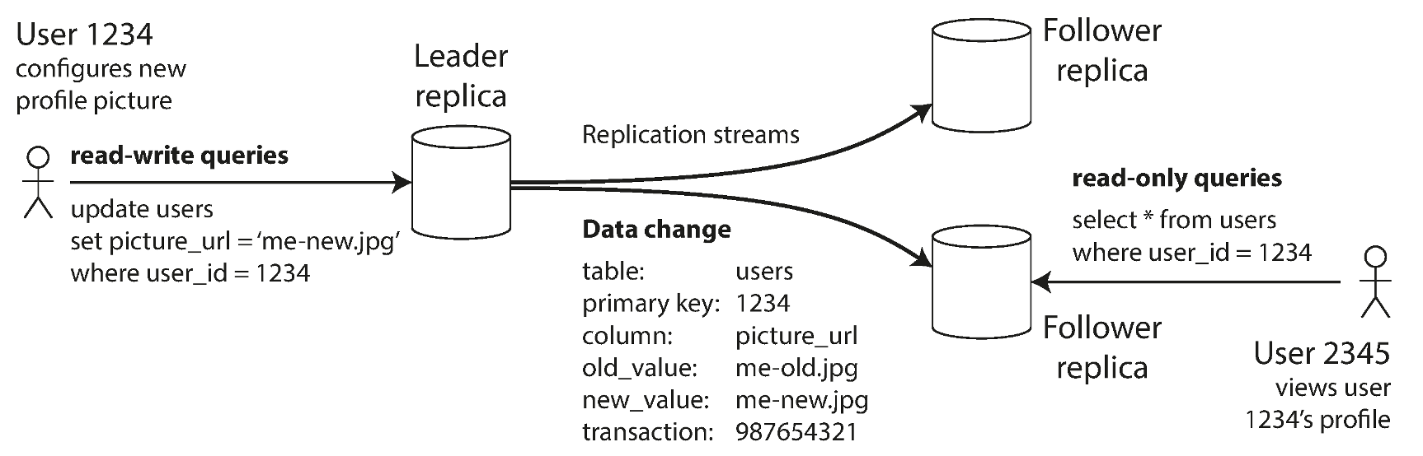
Leader-Based Replication
All writes from clients go to the leader
Leader sends replication info to the followers
Followers process the instructions from the leader
Clients can read from either the leader or followers

Slide 12
Leader-Based Replication
This write could NOT be sent to one of the followers… only the leader.

Slide 13
Leader-Based Replication - Very Common Strategy
Relational:
MySQL,
Oracle,
SQL Server,
PostgreSQL
NoSQL:
MongoDB,
RethinkDB (realtime web apps),
Espresso (LinkedIn)
Messaging Brokers: Kafka, RabbitMQ

Slide 14
How Is Replication Info Transmitted to Followers?
Replication Method | Description
Statement-based | Send INSERT, UPDATE, DELETEs to replica. Simple but error-prone due to non-deterministic functions like now(), trigger side-effects, and difficulty in handling concurrent transactions.
Write-ahead Log (WAL) | A byte-level specific log of every change to the database. Leader and all followers must implement the same storage engine and makes upgrades difficult.
Logical (row-based) Log | For relational DBs: Inserted rows, modified rows (before and after), deleted rows. A transaction log will identify all the rows that changed in each transaction and how they changed. Logical logs are decoupled from the storage engine and easier to parse.
Trigger-based | Changes are logged to a separate table whenever a trigger fires in response to an insert, update, or delete. Flexible because you can have application specific replication, but also more error prone.

Slide 15
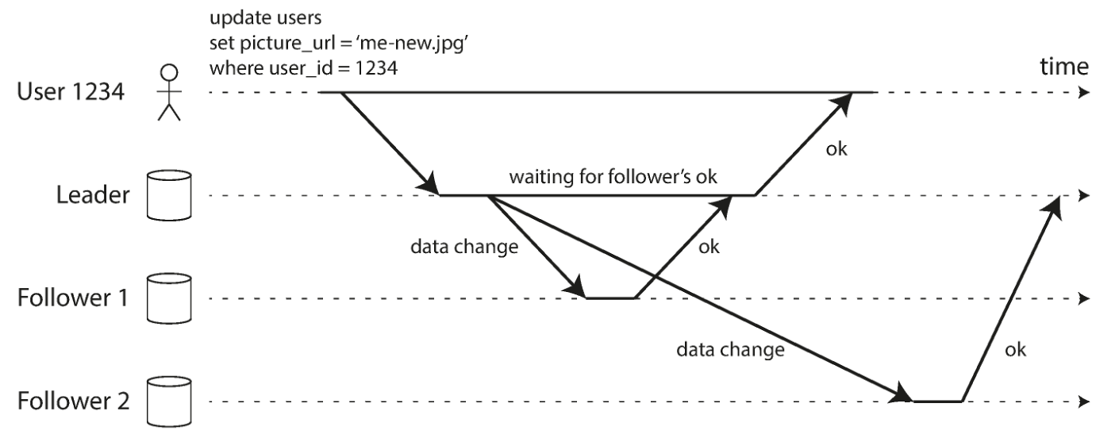
Synchronous vs Asynchronous Replication
Synchronous: Leader waits for a response from the follower
Asynchronous: Leader doesn’t wait for confirmation.
Synchronous:
Asynchronous:

Slide 16
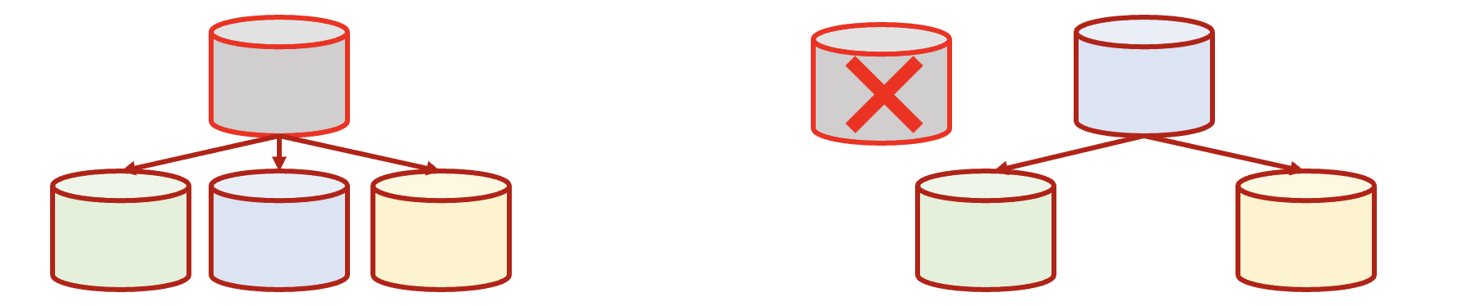
What Happens When the Leader Fails?
Challenges: How do we pick a new Leader Node?
Consensus strategy – perhaps based on who has the most updates?
Use a controller node to appoint new leader?
AND… how do we configure clients to start writing to the new leader?

Slide 17
What Happens When the Leader Fails?
More Challenges:
If asynchronous replication is used, new leader may not have all the writes How do we recover the lost writes? Or do we simply discard?
After (if?) the old leader recovers, how do we avoid having multiple leaders receiving conflicting data? (Split brain: no way to resolve conflicting requests.
Leader failure detection. Optimal timeout is tricky.

Slide 18
Replication Lag
Replication Lag refers to the time it takes for writes on the leader to be reflected on all of the followers.
Synchronous replication: Replication lag causes writes to be slower and the system to be more brittle as num followers increases.
Asynchronous replication: We maintain availability but at the cost of delayed or eventual consistency. This delay is called the inconsistency window.

Slide 19
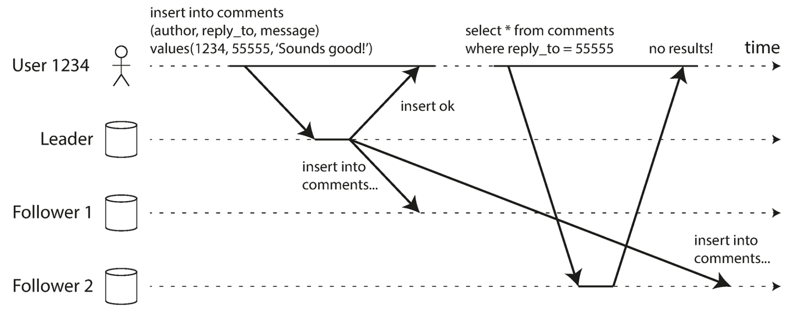
Read-after-Write Consistency
Scenario - you’re adding a comment to a Reddit post… after you click Submit and are back at the main post, your comment should show up for you.
Less important for other users to see your comment as immediately.

Slide 20
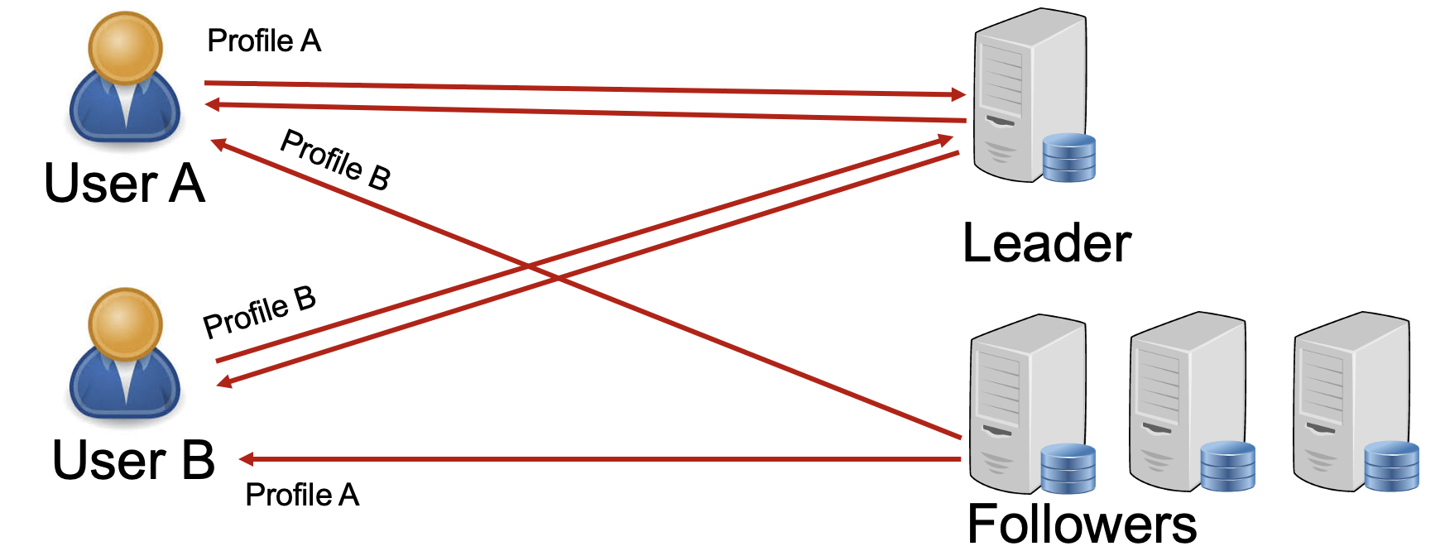
Implementing Read-After-Write Consistency
Method 1: Modifiable data (from the client’s perspective) is always read from the leader.

Slide 21
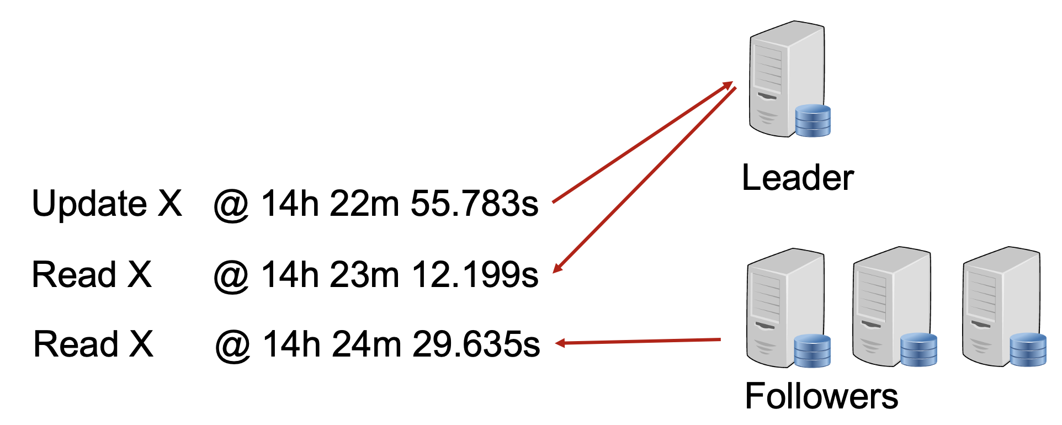
Implementing Read-After-Write Consistency
Method 2: Dynamically switch to reading from leader for “recently updated” data.
For example, have a policy that all requests within one minute of last update come from leader.

Slide 22
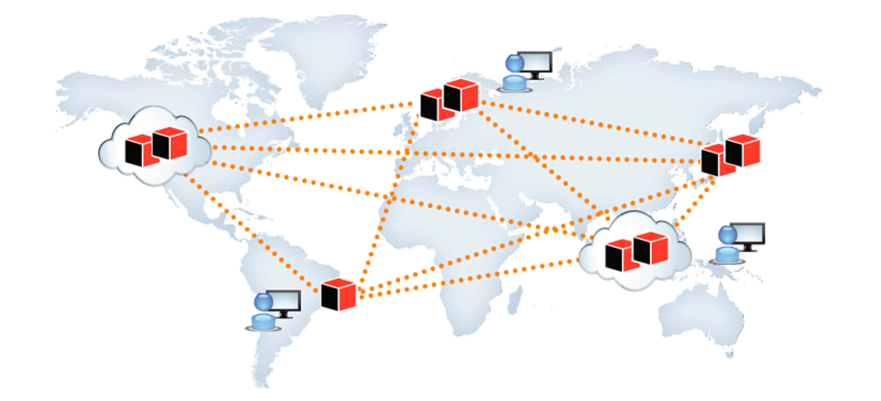
But… This Can Create Its Own Challenges
We created followers so they would be proximal to users. BUT… now we have to route requests to distant leaders when reading modifiable data?? :(

Slide 23
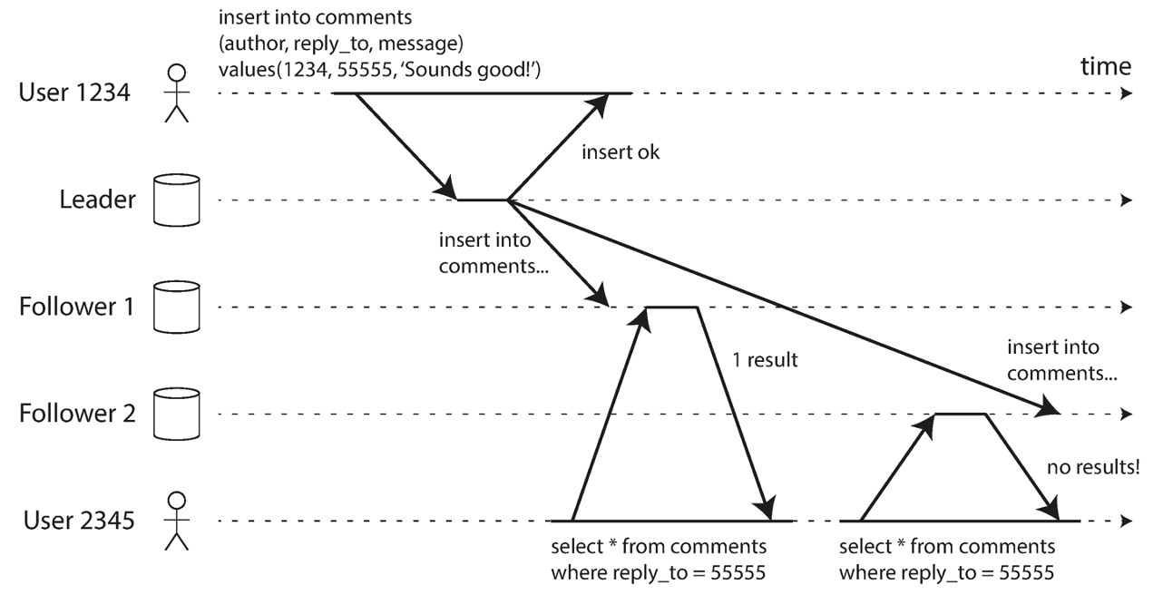
Monotonic Read Consistency
Monotonic read anomalies: occur when a user reads values out of order from multiple followers.
Monotonic read consistency: ensures that when a user makes multiple reads, they will not read older data after previously reading newer data.

Slide 24
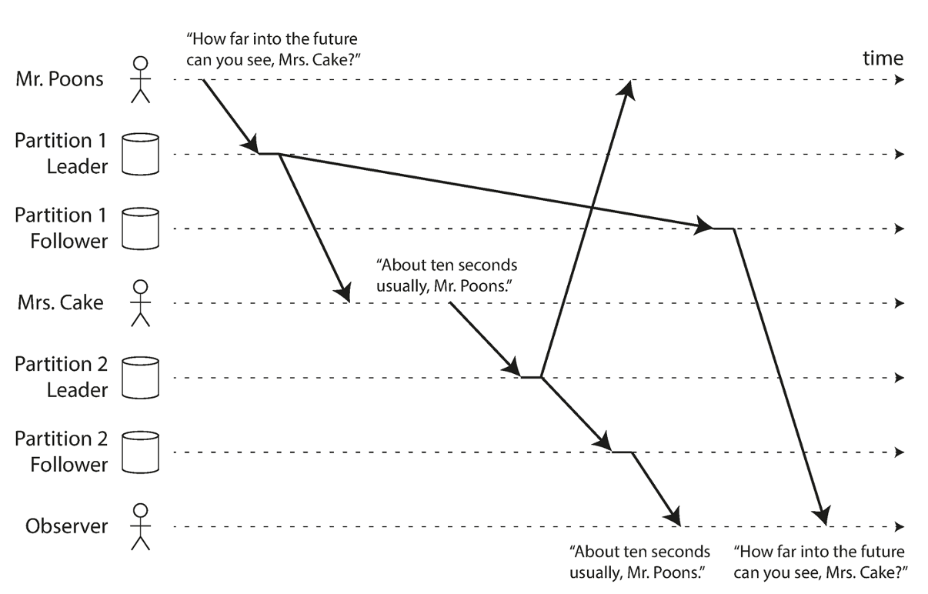
Consistent Prefix Reads
Reading data out of order can occur if different partitions replicate data at different rates. There is no global write consistency.
Consistent Prefix Read Guarantee - ensures that if a sequence of writes happens in a certain order, anyone reading those writes will see them appear in the same order.
How far into the future can you see, Ms. B?
A
About 10 seconds usually, Mr A.
B

Slide 25
??

